Slide 1
Project Metrics

Slide 2



Slide 3
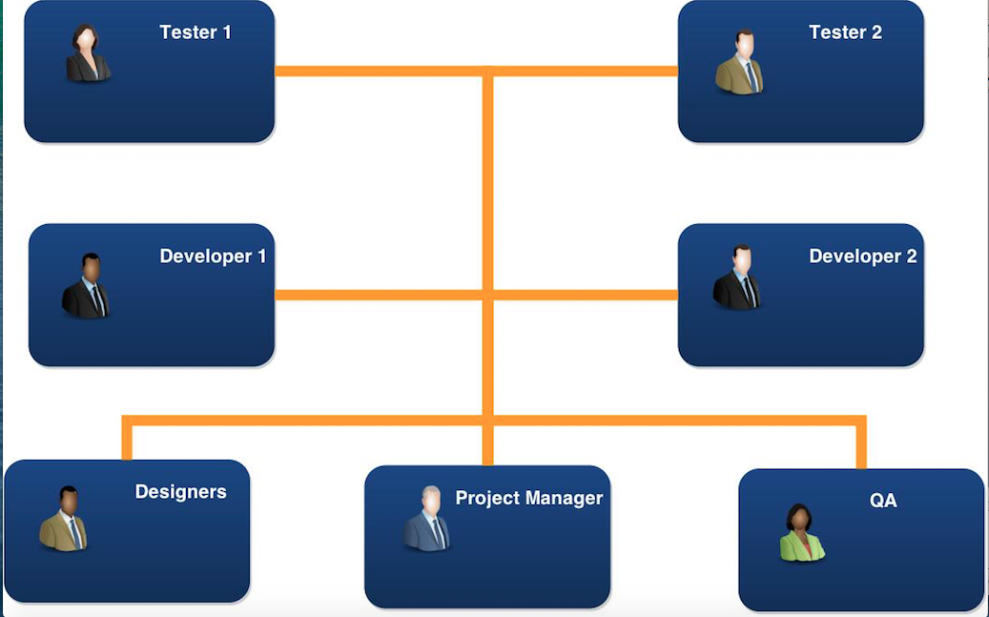

Slide 4
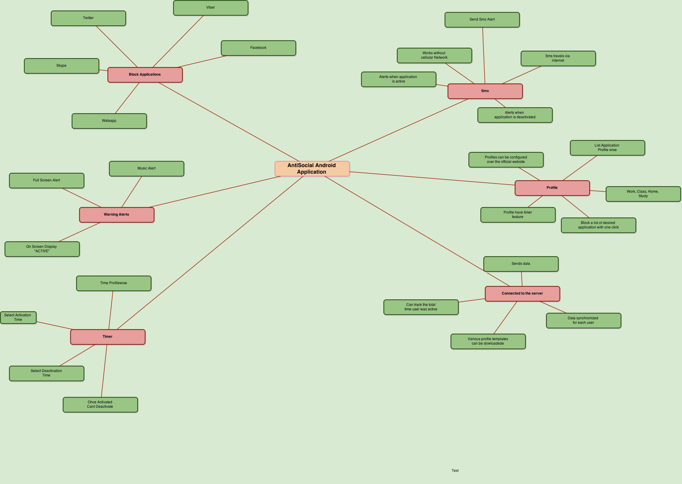

Slide 6
